Slide 1
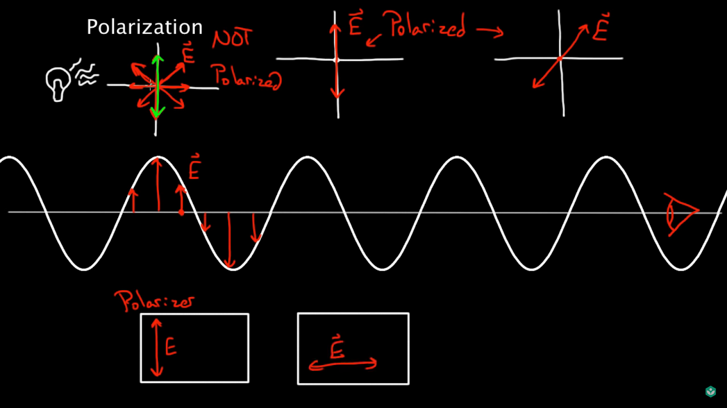
Light Polarization

Slide 2
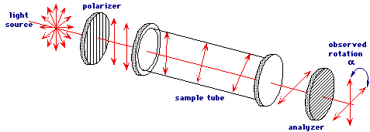
Optical Method
Measure intensity of light which polarization was changed by sugar(it provides optical rotation) and then filtered by polarizer.

